Slide 1
Titanic
Machine Learning From Disaster
Kristina Posner | Andrew Thiesse | Mohammad Alfadl | Anoushka Mahar

Slide 2
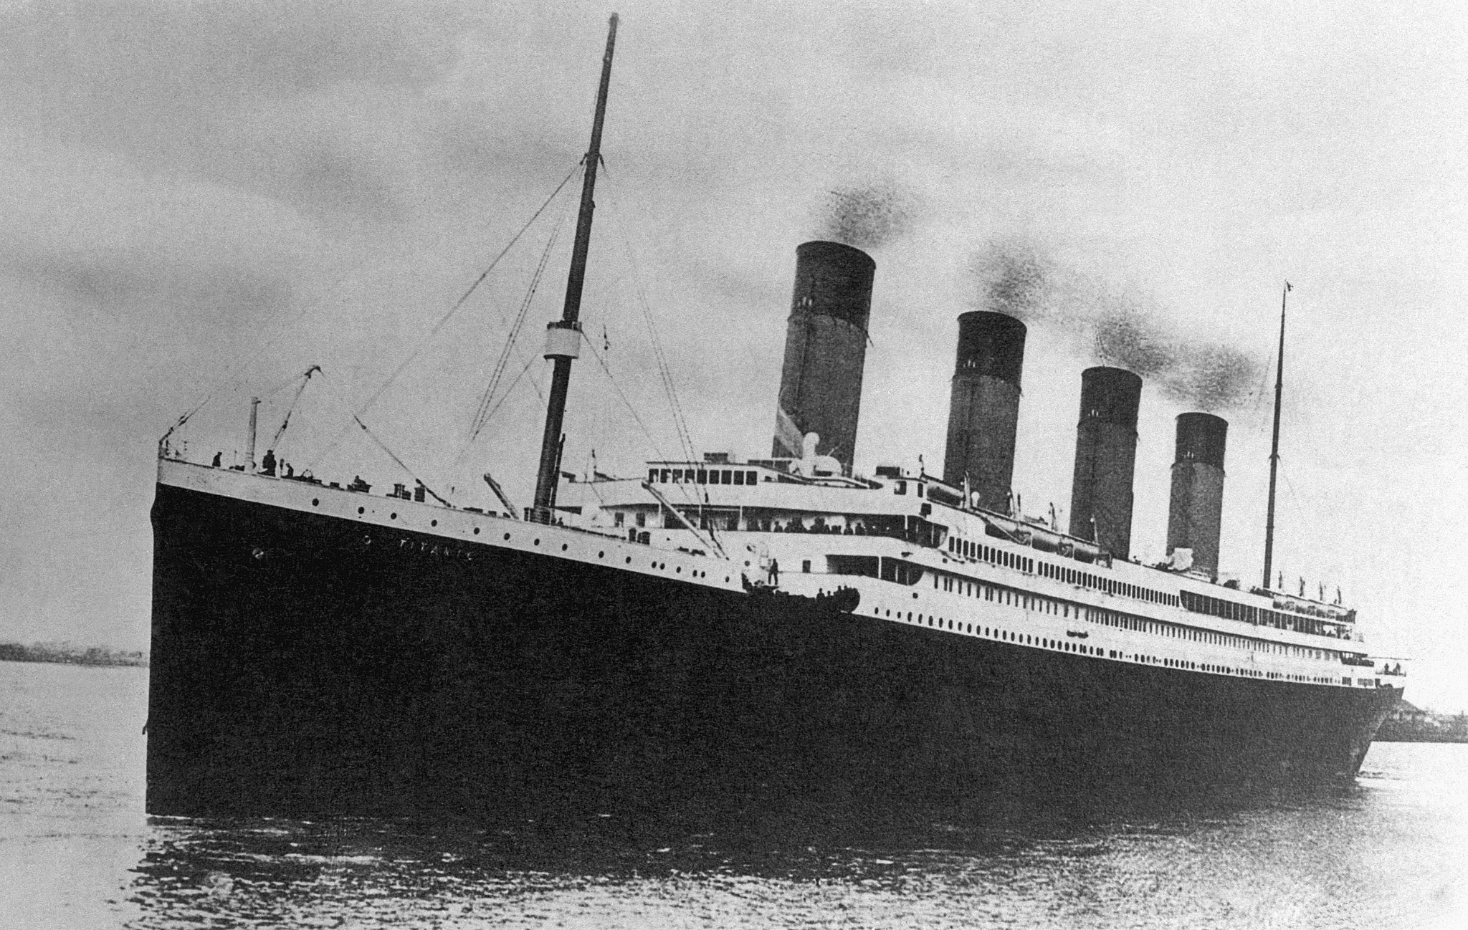
Table of Contents
Titanic Overview
Kaggle Competition Overview
Kaggle Competition Notebook Critique
Breakdown of our models
What we learned

Slide 3
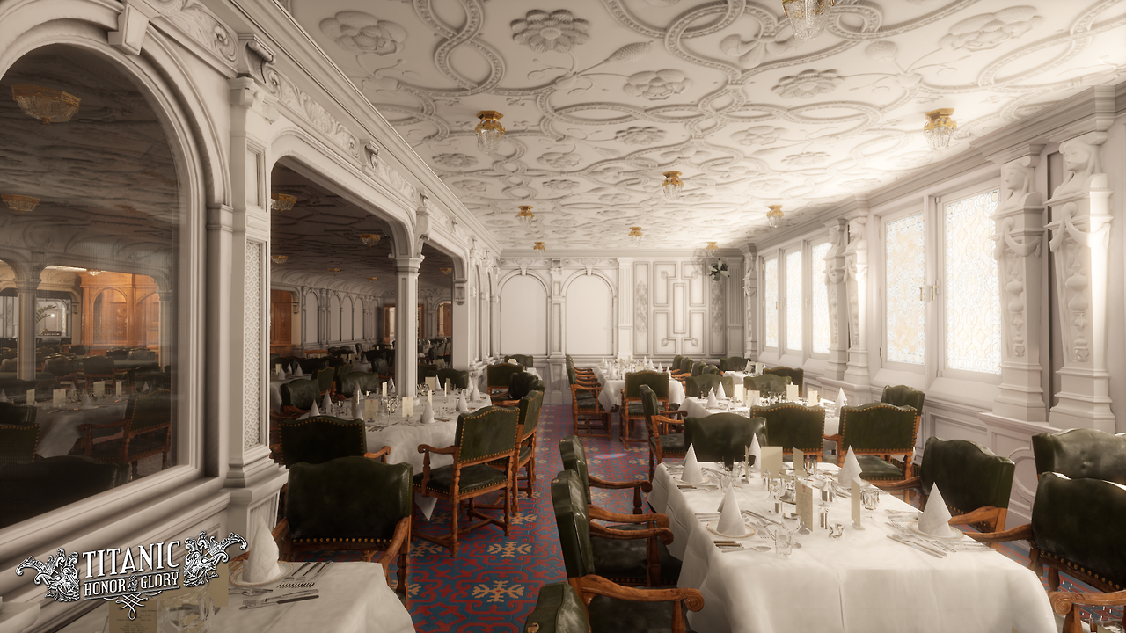
Titanic Overview
British Passenger Liner built from 1910-1912
Titanic was the largest ship afloat at the time she entered service
On 15 April 1912, the Titanic sank after hitting an iceberg during her maiden voyage
Of the estimated 2,224 passengers and crew aboard, more than 1,500 died, which made the sinking possibly one of the deadliest for a single ship up to that time.
Notes:
Titanic was 882 feet 9 inches (269.06 m) long with a maximum breadth of 92 feet 6 inches (28.19 m).
The interiors of the Olympic-class ships were subdivided into 16 primary compartments divided by 15 bulkheads that extended above the waterline. Eleven vertically closing watertight doors could seal off the compartments in the event of an emergency
This gave Titanic the ability to carry up to 64 wooden lifeboats which would have been enough for 4,000 people—considerably more than her actual capacity. However, the White Star Line decided that only 16 wooden lifeboats and four collapsibles would be carried, which could accommodate 1,178 people, only one-third of Titanic's total capacity.

Slide 4
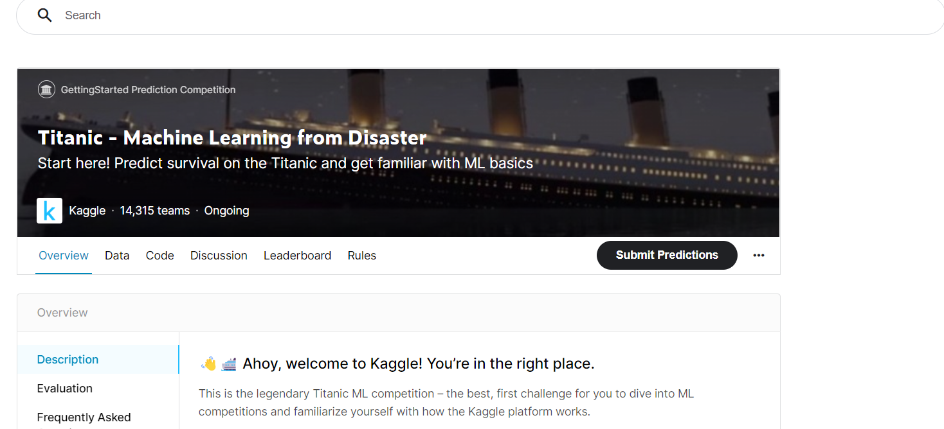
Kaggle Competition Overview
Build a predictive model to answer: “What people were going to survive the sinking of the Titanic?”
Data contains: 891 passengers in train data, 418 passengers in test data.
1,309 passengers overall
Contains basic passenger information: survival, ticket class, gender, age, # of siblings aboard, # of parents, ticket number, passenger fare, port of embarkation
Notes:
https://trainingmag.com/learning-from-the-titanic-business-lessons-on-crisis-management/
It is your job to predict if a passenger survived the sinking of the Titanic or not.
For each in the test set, you must predict a 0 or 1 value for the variable.
Train.csv will contain the details of a subset of the passengers on board (891 to be exact) and importantly, will reveal whether they survived or not, also known as the “ground truth”.
14300 teams have submitted kaggle competitions and counting.

Slide 5
Kaggle Competition Notebook Critiques
Runs only one model (randomForest) and excludes comparing other models
bagging
SVM
LDA
Does not describe the process (e.g., outcome, approach, model decision, VarImportance, etc)
Accuracy = 83.34%
Notes:
Critiqued Competitor: Easy R Titanic

Slide 6
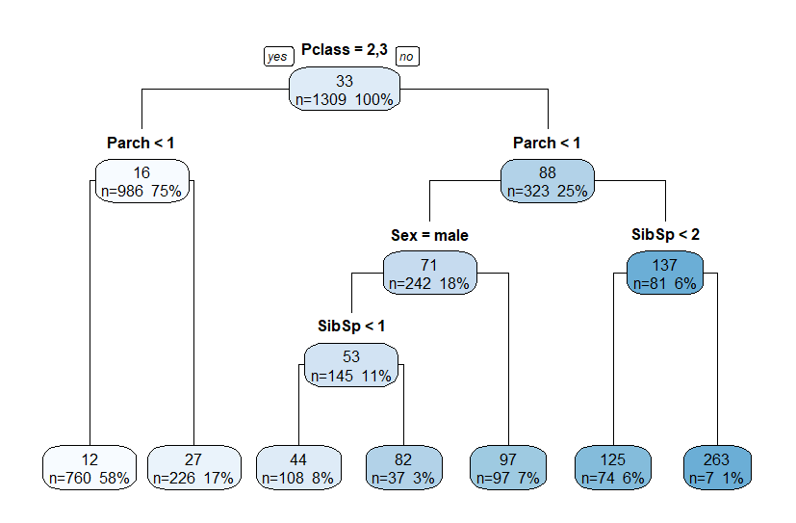
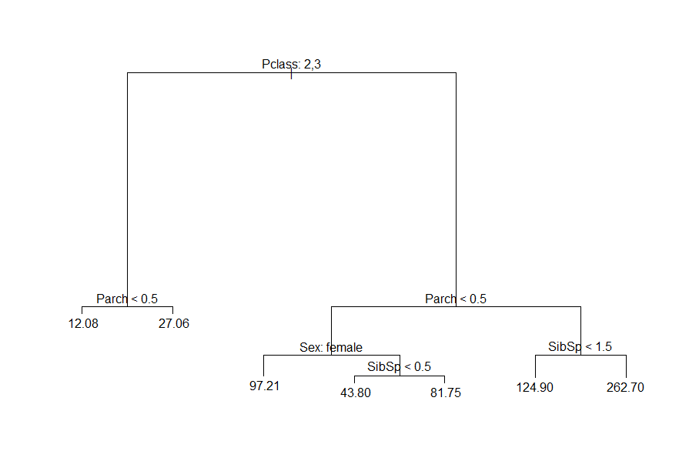
Kaggle Competition Notebook Critique: Library - Rpart vs. tree

Slide 7
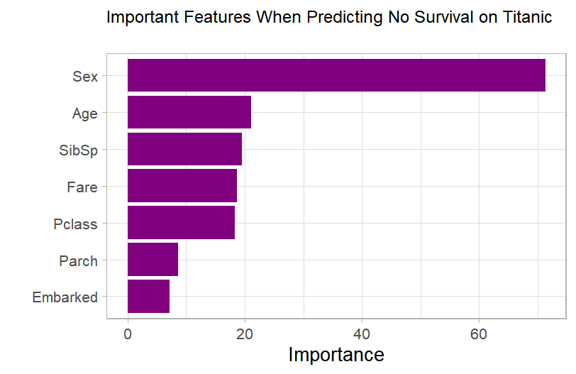
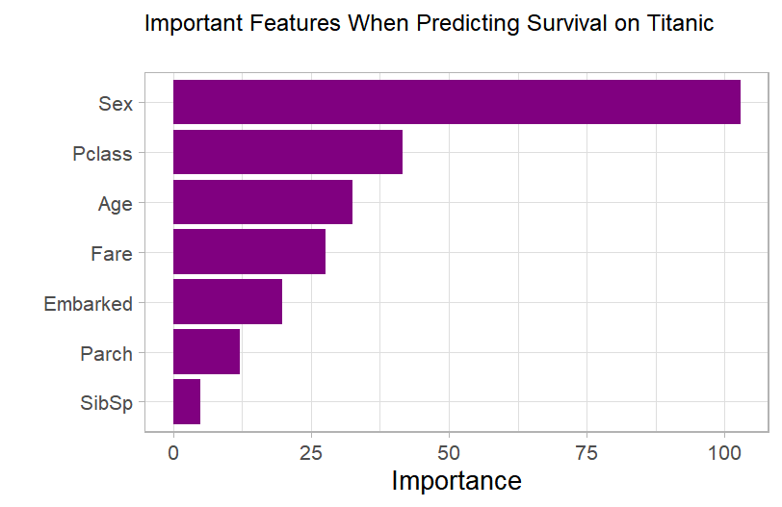
Team 3 Solution

Slide 8
What we learned
What variables influence survival rates of the titanic
Multiple Importance Variables for 2 classes
Gender, Age, Siblings, Pclass
Importance of different plots and models
Better understand dataset and information
Logistics: 86%, LDA: 87%
True to stereotype? Yes and No
Quantitative data backs up the qualitative data
Missing secret variable in Kaggle: boats!

Slide 9

Jack
Male
20 years old
Third class passenger
No family members on board
DEAD

Slide 10
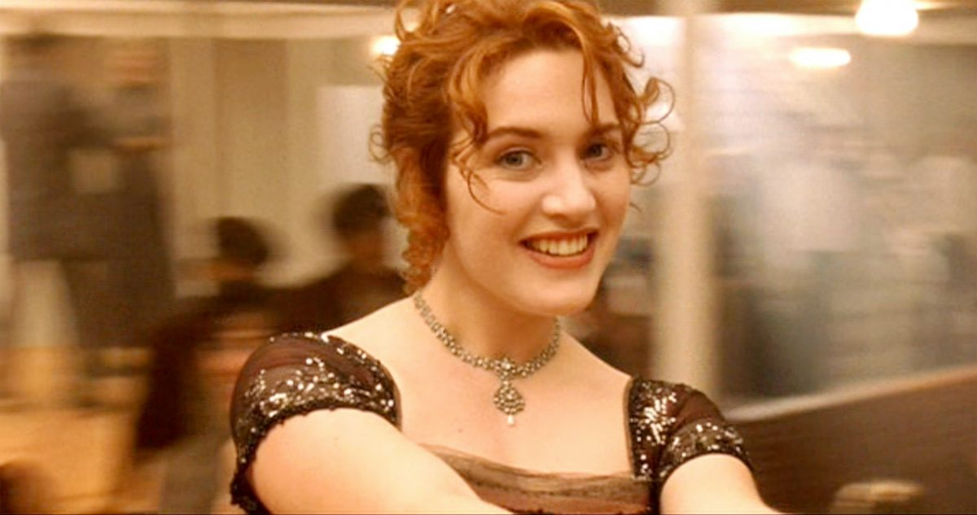
Rose
Female
17 years old
First Class
Family on board
ALIVE

